Slide 1


Smart Irrigation Automation using Soil Moisture and Weather Data.
Completed by:-Aniket Arjun Redekar
Internship ID : INTERNSHIP_175040797468551b2636342
AICTE Internship Student Registration ID : STU680258fbe5d2c1744984315

Slide 2

Learning Objectives
Understand how ML can optimize resource use in agriculture.
Explore multi-output classification with real sensor data.
Learn to preprocess and train AI models using Python and scikit-learn.
Implement rule-based and ML-based logic to automate irrigation decisions.
Save and evaluate trained models for future deployment.
To automate irrigation control for different land parcels by analyzing soil sensor data using machine learning, reducing water waste and increasing crop yield efficiency.
Source :
www.freepik.com/

Slide 3
Tools and Technology used
Languages: Python
Libraries:
pandas, matplotlib, seaborn for data analysis
scikit-learn for ML model (RandomForest, MultiOutputClassifier)
joblib for model saving
Platform: Google Colab

Slide 4
Methodology
Load simulated dataset (irrigation_machine.csv)
Drop unnecessary columns & split data into features/labels
Preprocess with MinMaxScaler
Apply Random Forest Classifier in multi-output mode
Evaluate model with classification report
Save model using joblib

Slide 5
Problem Statement:
In traditional agriculture, irrigation is often performed manually or based on fixed schedules without considering real-time environmental conditions. This leads to several inefficiencies:
Over-irrigation, which wastes water and harms crop health
Under-irrigation, which reduces yield and plant growth
Labor-intensive monitoring and decision-making processes
With the rise of smart farming, there's a growing need for an automated irrigation system that can:
Analyze real-time soil and weather sensor data
Make data-driven decisions about when and where to irrigate
Optimize water usage while maintaining crop health
The problem becomes more complex when there are multiple land parcels, each requiring independent decisions based on localized conditions. Thus, a scalable, intelligent, and efficient solution is necessary.

Slide 6
Solution:
To address this problem, a machine learning-based irrigation automation system was developed using a simulated dataset containing 20 sensor readings and 3 target parcel labels.
Key features of the solution:
Data Preparation: Loaded a CSV file (irrigation_machine.csv) simulating sensor readings like soil moisture, temperature, and environmental factors.
Preprocessing: Cleaned the dataset and applied MinMaxScaler to normalize feature values for consistent model input.
Model Building: Used a RandomForestClassifier wrapped in MultiOutputClassifier to predict irrigation needs for all three land parcels simultaneously.
Training and Testing: Performed an 80-20 train-test split to validate model accuracy.
Evaluation: Used classification_report to analyze precision, recall, and F1-score for each parcel.
Model Saving: Saved the trained model using joblib for future use or deployment.
This solution enables automated, real-time irrigation decision-making for multiple zones, reduces manual workload, saves water, and supports scalable smart agriculture.

Slide 7
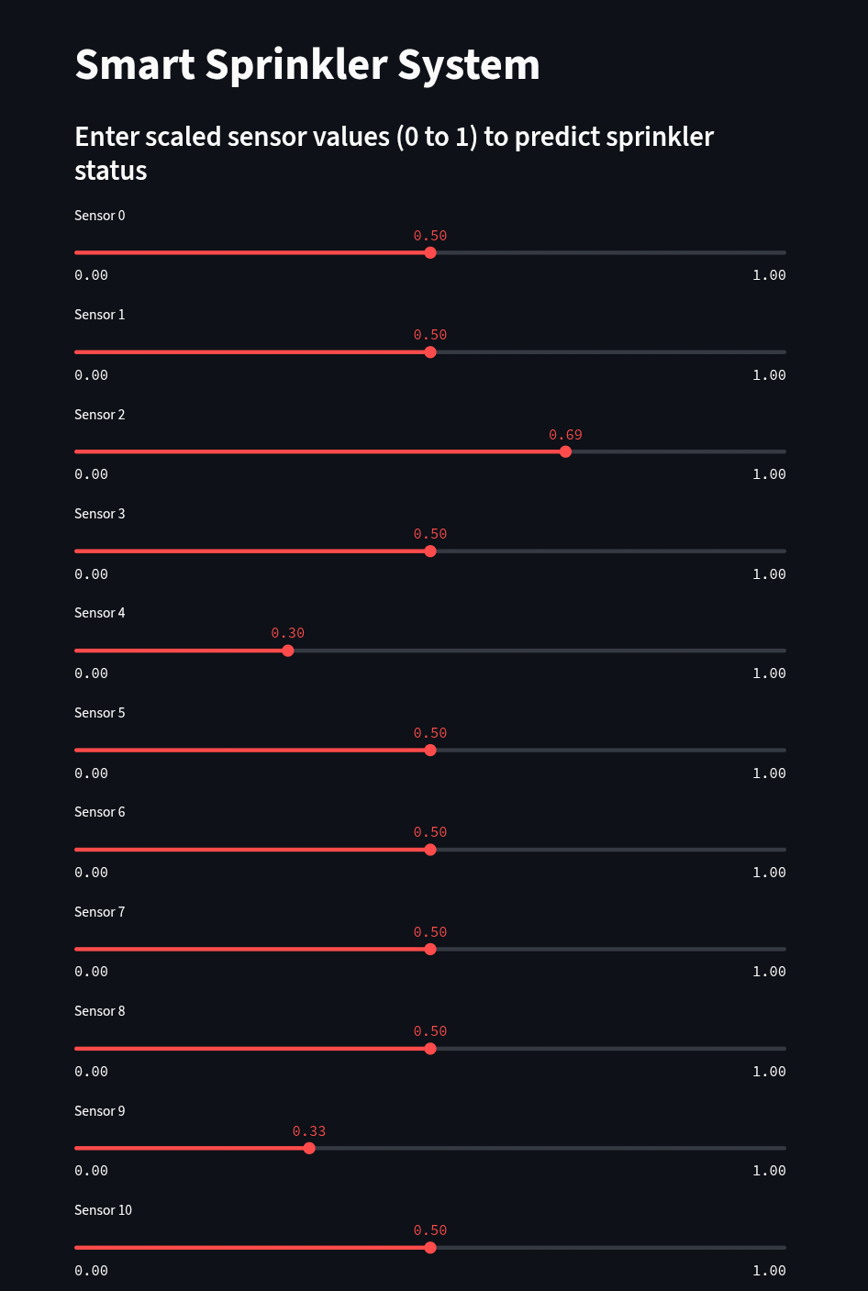
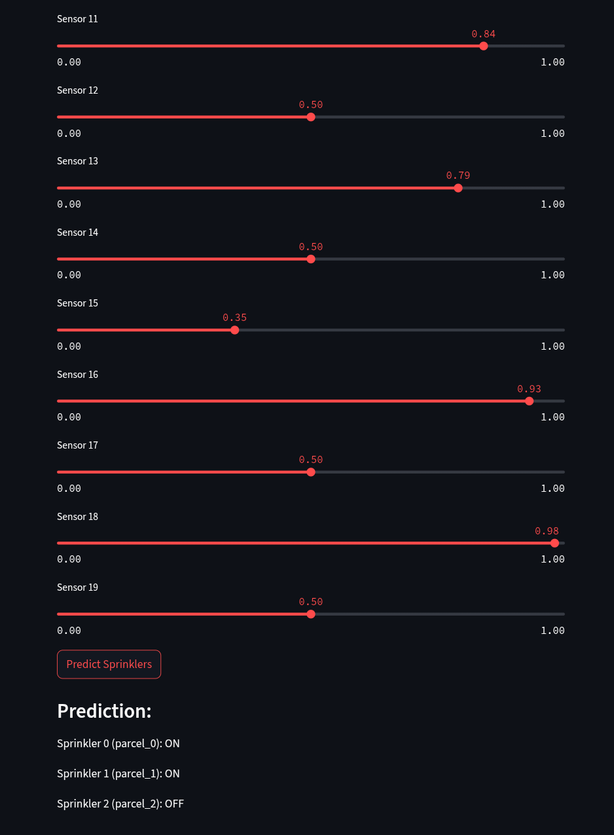
Screenshot of Output:

Slide 8
Conclusion:
Successfully built a multi-label smart irrigation system
Achieved clean separation of features and labels for real-world simulation
Built a foundational model that can be extended with real-time IoT input or deployed via Gradio/Streamlit
Enhanced practical ML skills in agriculture automation

